Slide 1
Identify AI Experts on Twitter
Keeping up-to-date with technological developments
Expand database of experts to follow
Tan Jia Hui

Slide 2
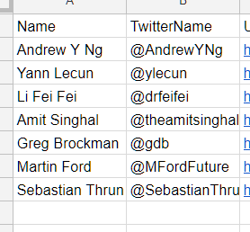
Background
Previous python course
Extract posts by AI experts to track developments in the field, spot trending topics and identify new experts
Build list of AI experts
Scrape tweets
Extract articles, topics and people mentioned
Original list had 7 experts
Grew to 250
All @ from tweets added to database

Slide 3
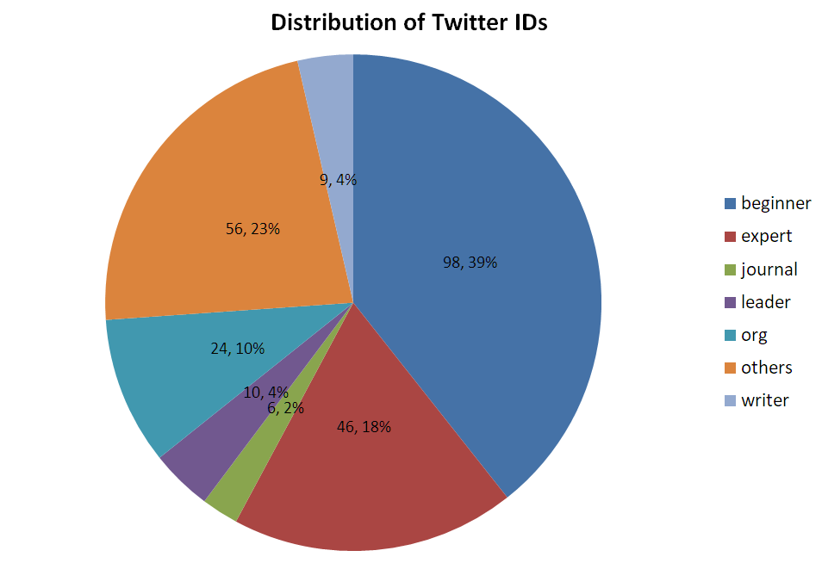
Current database
To follow
Labels added manually
Accuracy based on non-machine-learning methods is about 60%.
Notes:
250 - Grown from original list of 15 experts

Slide 4
Problem Statements
Can machine learning identify people to follow automatically?
Can machine learning categorise twitter userIDs automatically?

Slide 5
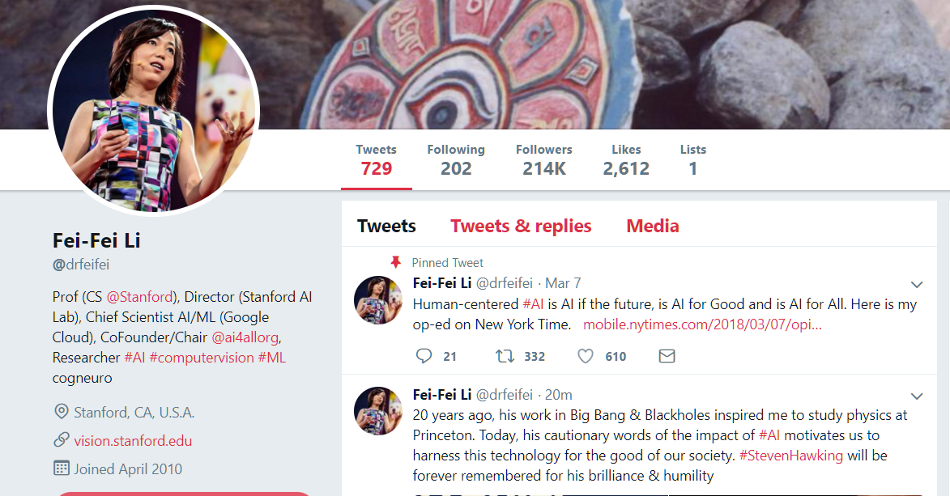
No. of Followers
UserID
Tweets
Description

Slide 6
Limitations
Tweets are very short at 160 characters.
Descriptions might/might not be true.
Descriptions might be missing.
Difficult to differentiate practitioners from journalists as the topics are similar.

Slide 7
Process
1 Data Preparation
2 Pre-Processing
3 Dimensionality Reduction
Extraction
Formatting
Feature Extraction (tweets)
Normalisation
Text (BOW, TF-IDF)
PCA
@,#, source, location
UserID
UserDescription
No. of Followers
Tweets (last 100)
Add target labels
SelectKBest
4 Model Selection
Grid Search
5 Modelling
SVM
KNN
Decision Tree
Random Forest
Clustering
K Means
6 Validation and Testing
Classification
Confusion Matrix
Accuracy Score
Precision, Recall, F-measure

Slide 8
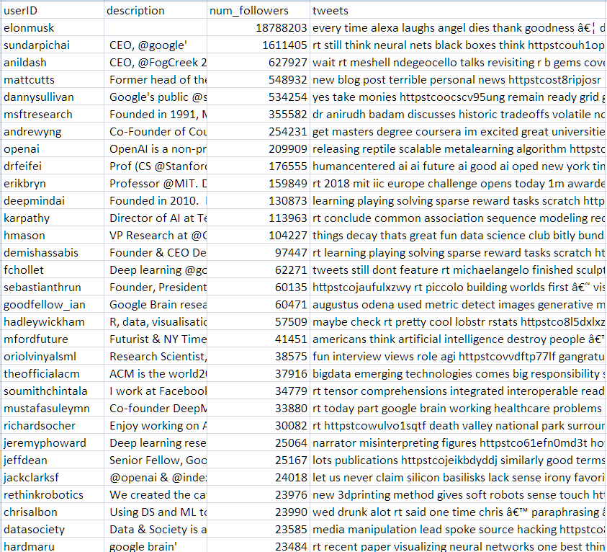
1 Data Preparation
Scrapped Twitter
using Tweepy
100 tweets in each cell

Slide 9
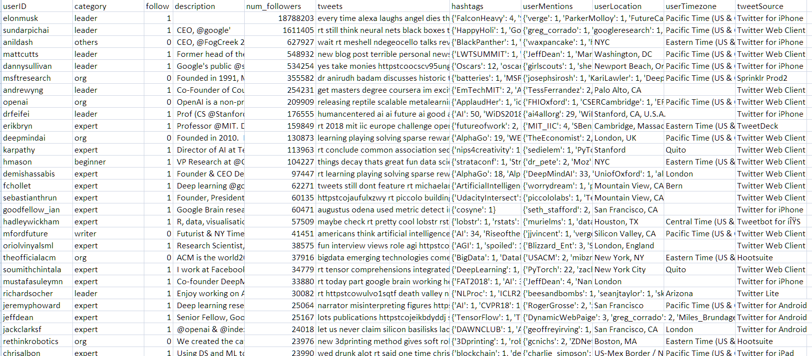
2 Pre-Processing
Extracted features from tweets
Added target labels – follow, category

Slide 10
Features to Explore
“Who you are”
Description
Number of followers
Organisations you belong to
Who are your followers
“How you tweet”
Frequency of tweets, retweets, etc
Source of tweet e.g. browser used
“What you tweet”
# used – what trends you tweet about
@ used – who you tweet about
Words used (BOW)
Topic modelling of tweets (LDA)

Slide 11
Feature 1a - Description
Hypothesis
Experts will use certain keywords to describe themselves.
Explore Bag of Words representations
NLTK
Collocations
Freqdist
GENSIM
LDA
TFIDFVectoriser

Slide 12
Feature 1a – Description NLTK - Collocations
Follow=0
deep learning; machine learning; blog post; neural network; looking forward; data science; artificial intelligence; open source; feel like; neural net; look like; reinforcement learning; computer vision; adversarial example; high school; common sense; transpiles autotuned; google brain; supreme court; accepting application
Follow=1
machine learning; google brain; deep learning; computer science; natural language; neural net; assistant professor; research scientist; data science; trying understand; distributed system; data scientist; former head; grad student; postdoctoral researcher; associate professor; phd student; founder ceo; student like; professor computer

Slide 13
Feature 1a – Description NLTK - FreqDist
Follow=0
[('new', 777), ('like', 759), ('learning', 672), ('one', 630), ('work', 608), ('people', 568), ('think', 543), ('great', 532), ('paper', 530), ('get', 529), ('would', 499), ('data', 494), ('see', 456), ('make', 451), ('good', 443), ('deep', 435), ('time', 423), ('need', 422), ('really', 392), ('also', 376)]
Follow=1
[('machine', 32), ('learning', 30), ('research', 28), ('data', 24), ('scientist', 22), ('professor', 21), ('computer', 17), ('google', 16), ('science', 16), ('researcher', 15), ('phd', 14), ('deep', 13), ('director', 10), ('working', 9), ('opinion', 9), ('computational', 9), ('former', 8), ('team', 8), ('student', 8), ('author', 8)]

Slide 14
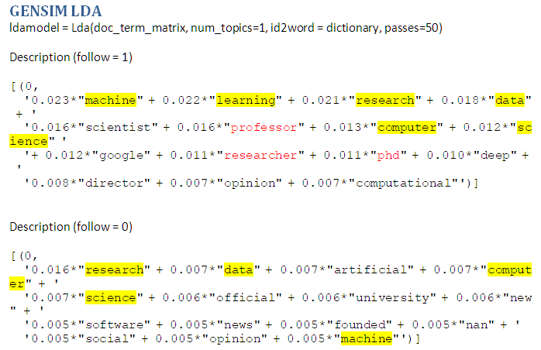
Feature 1a – Description GENSIM - LDA

Slide 15
Feature 1a – Description GENSIM - TFIDFVectorizer
Follow=0
'engineer', 'former', 'hacker', 'product', 'data', 'featured', 'everyone', 'environment', 'fifteen', 'equips', 'era', 'ethical', 'every', 'examining', 'federal', 'feed', 'embryo', 'fake', 'fan', 'fantasy'
Follow=1
'starcraft', 'play', 'definitely', 'personal', 'facebook', 'opinion', 'research', 'fighting', 'fact', 'fanatic', 'father', 'fellow', 'fight', 'focused', 'founding', 'freelance', 'executive', 'former', 'formerly', 'founded'

Slide 16
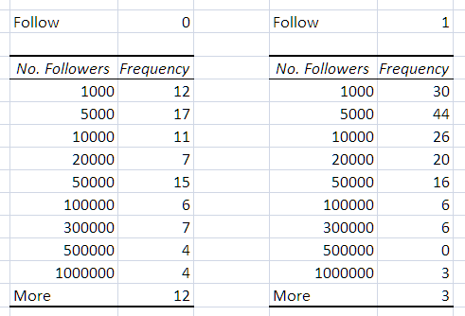
Feature 1b – No. of Followers
Hypothesis
Some experts have few followers, some journalists have many.

Slide 17
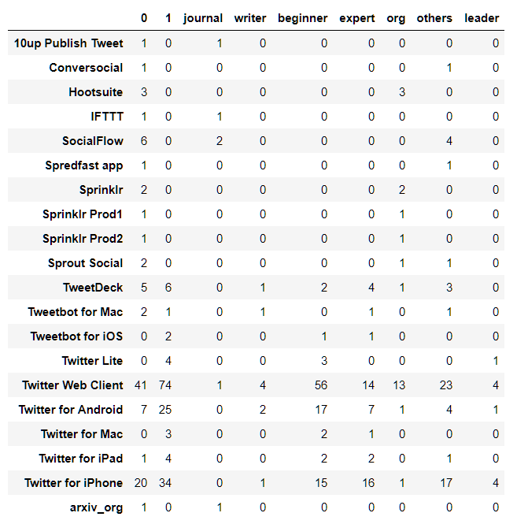
Feature 2b – Source of Tweet
Hypothesis
Organisations might use different sources.
Non-Experts

Slide 18
Feature 3a – #
Hypothesis
Experts will mention more technical topics.
Hashtags from follow=1
[('AI', 262), ('rstats', 91), ('NIPS2017', 75), ('MachineLearning', 74), ('DeepLearning', 41), ('AAAI2018', 36), ('deeplearning', 30), ('DataScience', 29), ('machinelearning', 27), ('AlphaGo', 26), ('TensorFlow', 26), ('FAT2018', 20), ('Oscars', 19), ('rladies', 19), ('NLProc', 17), ('IWD2018', 16), ('BAVM2017', 16), ('ML', 15), ('dataviz', 14), ('notGDC', 13), ('iwd2018', 13), ('ICLR2018', 12), ('Python', 12), ('python', 12), ('OutOfOrder', 12), ('AIES2018', 12), ('ai', 11), ('DataFramed', 11), ('aiethics', 11), ('AlphaZero', 10), ('nips2017', 10), ('LeadDevAustin', 10),
Hashtags from follow=0
('AI', 247), ('AlphaGo', 46), ('DataScience', 44), ('TensorFlow', 42), ('NIPS2017', 39), ('machinelearning', 37), ('AINow2017', 36), ('YouTubeTaughtMe', 36), ('AI2', 30), ('cosyne18', 27), ('RiseoftheRobots', 26), ('robots', 22), ('MachineLearning', 22), ('AAAI2018', 21), ('WomenInSTEM', 20), ('Oscars', 20), ('NIPS2013', 20), ('MSRPodcast', 17), ('NLP', 17), ('STEM', 16), ('ChooseSTEM', 16), ('rstats', 16), ('GirlsInSTEM', 15), ('robotics', 15), ('YourBudget2018', 15),
Notes:
Number of times the # is used, can be multiple times per user -> Monitor trends so ok to have multiple per user

Slide 19
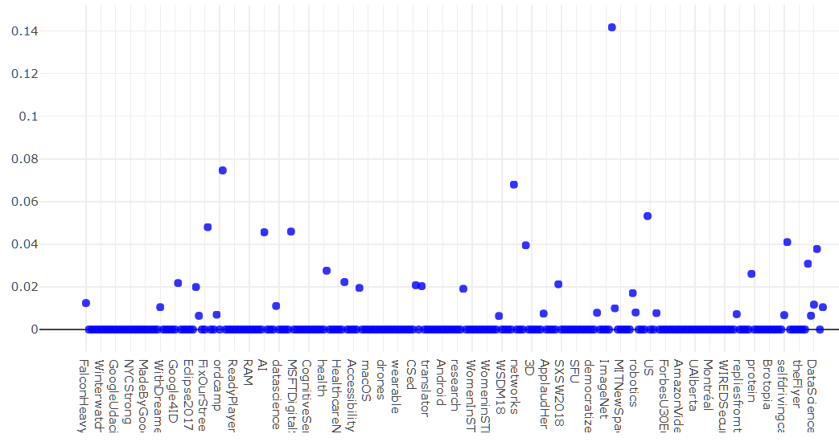
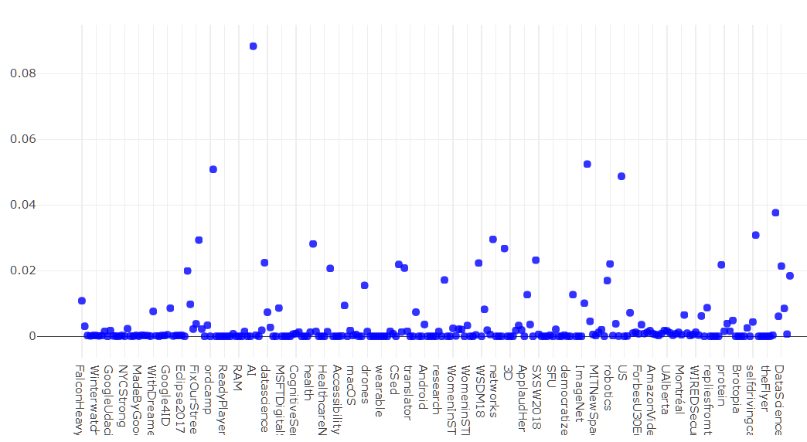
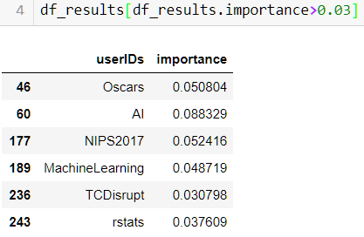
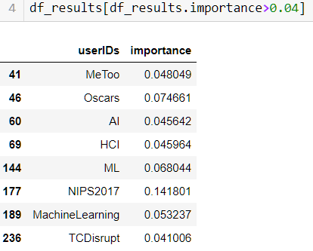
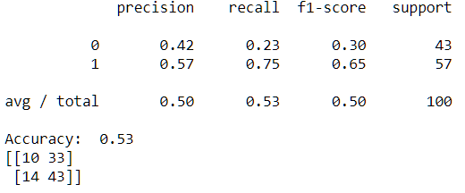
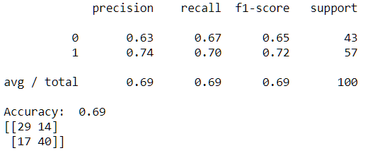
Feature 3a – #
Check for key indicators
Decision Tree
Random Forest

Slide 20
Feature 3b – @
Hypothesis
Experts are likely to know and reference each other.
@ from follow=1
('fchollet', 47), ('goodfellow_ian', 46), ('zacharylipton', 41), ('hardmaru', 39), ('jeremyphoward', 38), ('OpenAI', 37), ('Miles_Brundage', 37), ('JeffDean', 34), ('jackclarkSF', 28), ('dennybritz', 26), ('DeepMindAI', 25), ('tdietterich', 25), ('Smerity', 25), ('googleresearch', 24), ('ylecun', 24), ('PyTorch', 24), ('yoavgo', 24), ('mark_riedl', 24), ('TensorFlow', 23), ('GaryMarcus', 22), ('karpathy', 21), ('soumithchintala', 21), ('deliprao', 21), ('Google', 20), ('drfeifei', 19), ('beenwrekt', 19), ('fhuszar', 19), ('elonmusk', 18), ('NipsConference', 18), ('ilyasut', 17), ('roydanroy', 17), ('math_rachel', 17), ('poolio', 16), ('nytimes', 16), ('catherineols', 16), ('rasbt', 16), ('jakevdp', 16), ('AndrewYNg', 15), ('egrefen', 15), ('KLdivergence', 15), ('ogrisel', 15), ('dustinvtran', 15),
@ from follow=0
[('katecrawford', 12), ('nytimes', 12), ('DeepMindAI', 11), ('fchollet', 10), ('OpenAI', 9), ('qz', 8), ('Google', 7), ('YouTube', 7), ('drfeifei', 7), ('TechCrunch', 7), ('techreview', 7), ('AINowInstitute', 7), ('tdietterich', 7), ('jackclarkSF', 7), ('Miles_Brundage', 7), ('Uber', 6), ('goodfellow_ian', 6), ('PartnershipAI', 6), ('zacharylipton', 6), ('fhuszar', 6), ('jovialjoy', 6), ('deliprao', 6), ('erichorvitz', 5), ('nvidia', 5), ('GaryMarcus', 5), ('FT', 5), ('jeremyphoward', 5), ('ch402', 5), ('roydanroy', 5), ('TensorFlow', 5), ('allenai_org', 5), ('JanelleCShane', 5), ('sciencemagazine', 5), ('allenai_org', 5), ('roydanroy', 5)
Non-experts in RED, new in blue
Notes:
1 @ per person

Slide 21
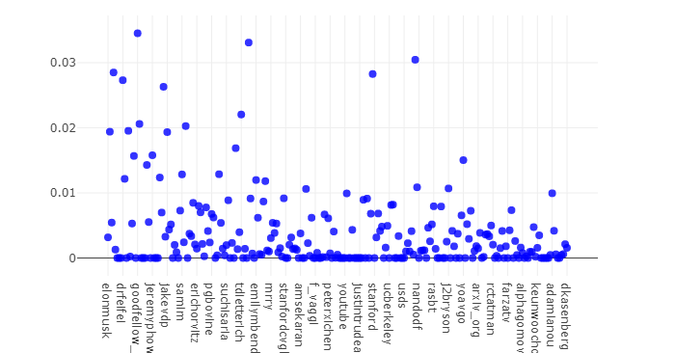
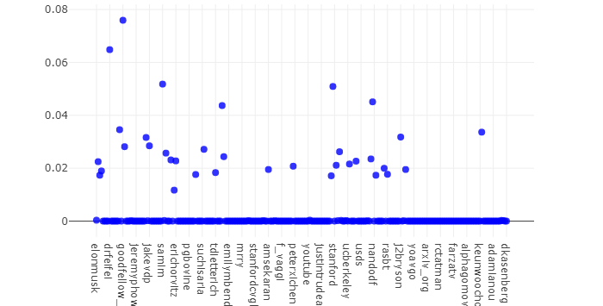
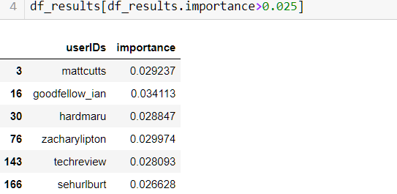
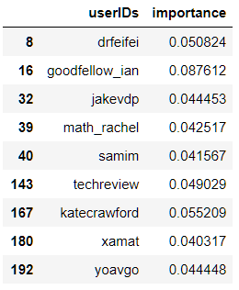
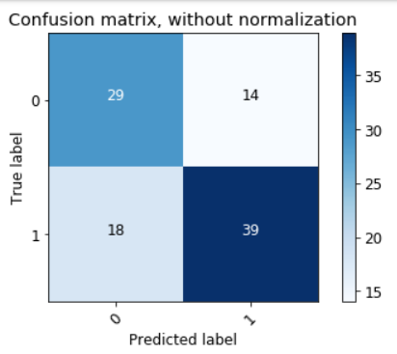
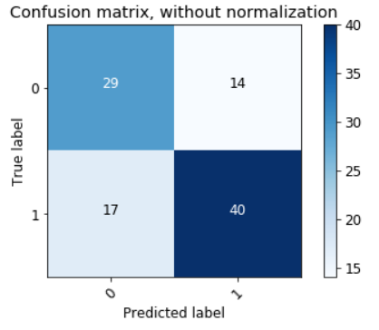
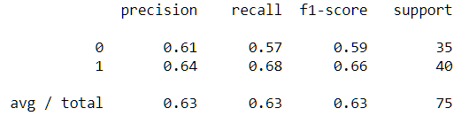
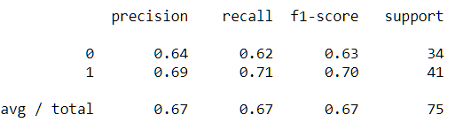
Feature 3b – @
Check for key indicators
Decision Tree
Random Forest

Slide 22
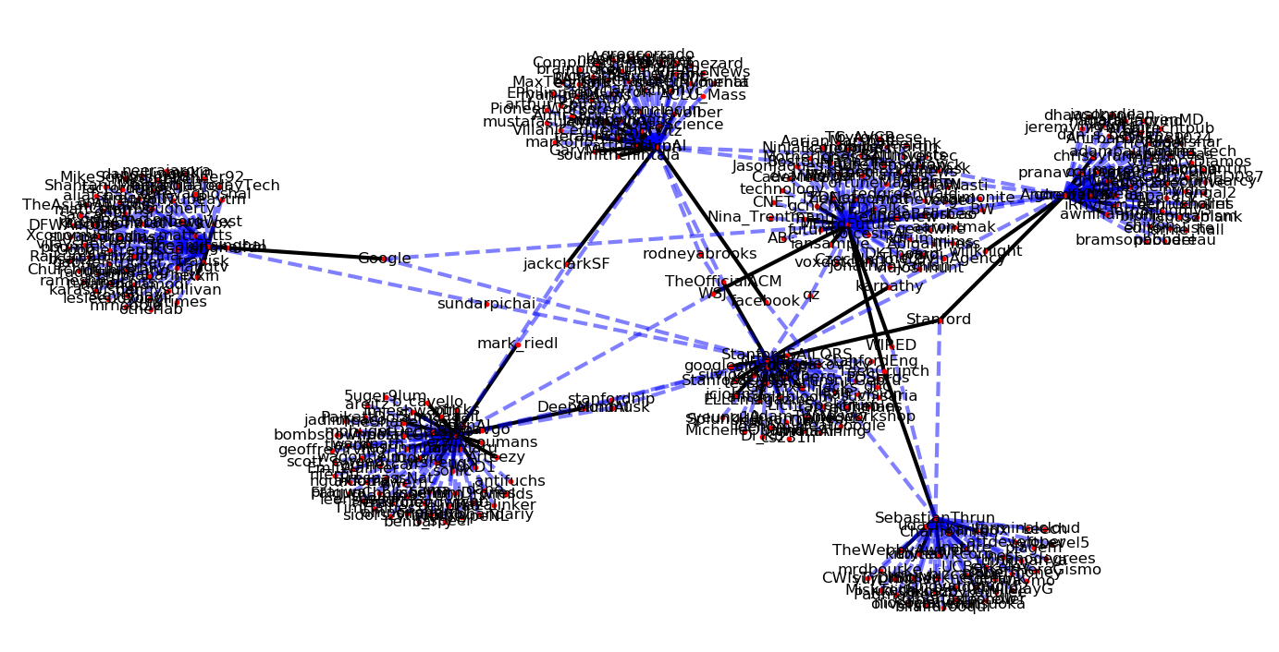

Slide 23
Feature 3c – Words used in Tweets
Hypothesis
Experts might use more technical terms.
Explore Bag of Words representations
NLTK
GENSIM
N-grams?

Slide 24
Feature 3c – Words used in Tweets GENSIM - Similarity
Tweet0
Description0, Description1-> array([0.407223, 0.33568 ]
Description1, Tweet1 -> array([0.00197649, 0.9409678 ]
Tweet1
Description0, Tweet0 -> array([0.00224408, 0.9402755 ]
Description0, Description1-> array([0.341220, 0.349624]
Tweets are of 94% similarity!

Slide 25
Feature 3d – Topic Modelling
Hypothesis
Topics are likely to be similar.
Explore topic models
GENSIM - LSI
GENSIM - LDA
N-grams?

Slide 26
Feature 3d – Topic Modelling GENSIM - LSI
Follow=0
(0, '0.219*"new" + 0.168*"like" + 0.155*"one" + 0.143*"work" + 0.135*"learning" + 0.132*"time" + 0.131*"see" + 0.131*"people" + 0.124*"paper" + 0.123*"data"')
Follow=1
(0, '0.201*"learning" + 0.192*"work" + 0.190*"like" + 0.187*"new" + 0.170*"one" + 0.166*"paper" + 0.152*"people" + 0.148*"data" + 0.142*"great" + 0.134*"time"')

Slide 27
Feature 3d – Topic Modelling GENSIM - LDA
Follow=0
(0, '0.000*"see" + 0.000*"like" + 0.000*"work" + 0.000*"new" + 0.000*"learning"'),
(1, '0.005*"new" + 0.004*"like" + 0.004*"one" + 0.003*"work" + 0.003*"learning"'),
(2, '0.000*"new" + 0.000*"like" + 0.000*"time" + 0.000*"know" + 0.000*"think"')
Follow=1
(0, '0.000*"paper" + 0.000*"like" + 0.000*"learning" + 0.000*"one" + ' '0.000*"time"')
(1, '0.005*"learning" + 0.005*"work" + 0.005*"like" + 0.005*"new" + 0.005*"one"')
(2, '0.000*"work" + 0.000*"new" + 0.000*"paper" + 0.000*"great" + 0.000*"one"')

Slide 28
Summary of Feature Selection
 | Feature | Hypothesis/Intuition | Result | Good Feature?
1a | User Description | Experts will use certain keywords to describe themselves. | Keywords identify experts “professor, researcher, pHD” | Yes
1b | No. of followers | Some experts have few followers, some journalists have many. | No correlations | No
2b | Source of Tweet | Organisations might use different sources. | Sources that are not browsers/mobile likely to be used by org/journalists | Yes
3a | # | Experts will mention more technical topics. | Topics might need to be labelled as technical or not. | No/Maybe
3b | @ | Experts are likely to know and reference each other. | Experts reference each other more BUT non-experts also reference experts | No/Maybe
3c | Tweets | Experts might use more technical terms. | Both datasets are very similar (94% similarity from GENSIM) | No
3d | Tweet topics | Topics are likely to be similar. | Extracted topics are almost identical. | No

Slide 29
Process
1 Data Preparation
2 Pre-Processing
3 Dimensionality Reduction
Extraction
Formatting
Feature Extraction (tweets)
Normalisation
Text (BOW, TF-IDF)
PCA
@,#, source, location
UserID
UserDescription
No. of Followers
Tweets (last 100)
Add target labels
SelectKBest
4 Model Selection
Grid Search
5 Modelling
SVM
KNN
Decision Tree
Random Forest
Clustering
K Means
6 Validation and Testing
Classification
Confusion Matrix
Accuracy Score
Precision, Recall, F-measure

Slide 30
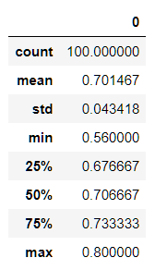
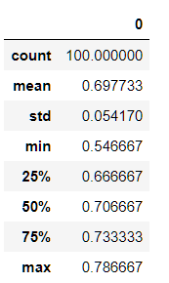
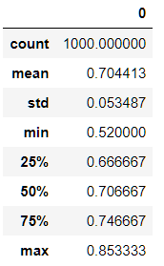
Methodology
Benchmark on Individual Features
Add more features
Description
Tweet Source
#
@
Check for improvement
Uses Random Forest
Tweet Source
+
Description
Description Only
65-70%
Tweet Source Only
65-70%
Both
Same or slightly better
Added # Only
<50%
Added @ Only
55%
Notes:
tweetSource 0.8, description 0.5

Slide 31
pipeline = Pipeline([
# Use FeatureUnion to combine the features from description and tweetSource
('union', FeatureUnion(
transformer_list=[
('tweetSource', Pipeline([
('selector', ItemSelector(key='tweetSource')),
("pca", PCA(n_components=5)),
("univ_select", SelectKBest(k=3)),
])),
# Pipeline for bag-of-words model for description
('description', Pipeline([
('selector', ItemSelector(key='description')),
('tfidf', TfidfVectorizer()),
('best', TruncatedSVD(n_components=50)),
])),
],
# weight components in FeatureUnion
transformer_weights={
'tweetSource': 1,
'description': 1,
},
)),
# Use a SVC classifier on the combined features
('tree', RandomForestClassifier(n_estimators = 100, n_jobs=-1)),
])

Slide 32
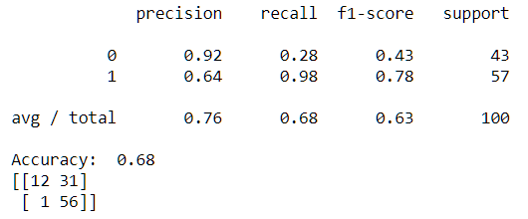
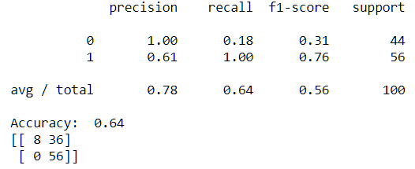
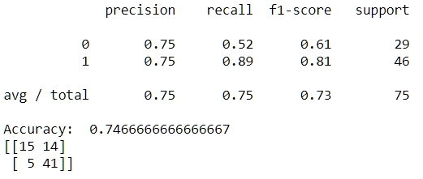
Description Only
Both
Tweet Source Only
Notes:
pipeline_text = Pipeline([
('tfidf', TfidfVectorizer()),
('best', TruncatedSVD(n_components=50)),
('model', RandomForestClassifier(n_estimators = 100, n_jobs=-1)), # train on TF-IDF vectors w/ Naive Bayes classifier
])
("pca", PCA(n_components=5)),
("univ_select", SelectKBest(k=3)),
('model', RandomForestClassifier(n_estimators = 100, n_jobs=-1)

Slide 33
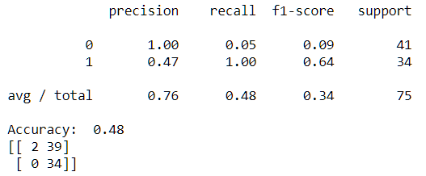
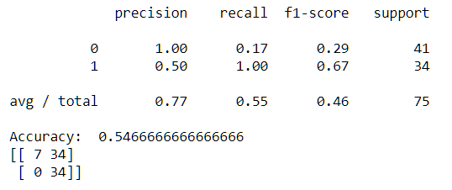
# Only
@ Only

Slide 34
Ideas to improve the model
Improve Data
1 Description: Extract @
Match against @ and # from tweets?
People mostly likely to have @ (organisations)
2 @: Select subset
Improve model
3 Ensemble methods: Gradient boost
4 Optimise hyper-parameters
Notes:
0.7128 0.84 0.56

Slide 35
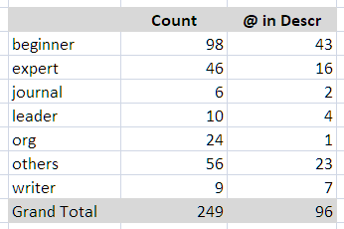
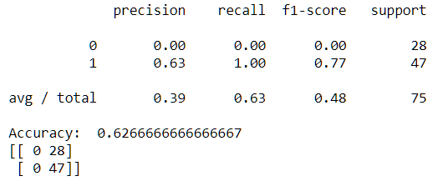
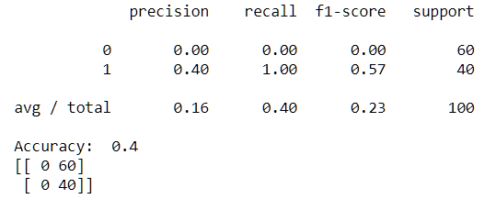

1 Extract @ from Description
One Feature
Total
No improvement
BUT Most/All should be organisations -> Update data label

Slide 36
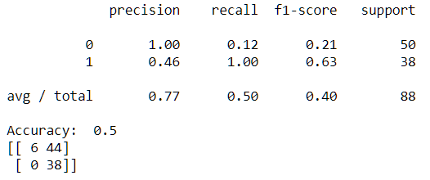
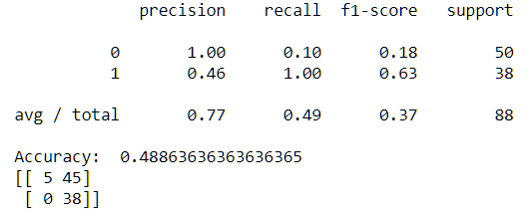
2 @: Select sub-sets
Experts
No improvement
Follow=1
No improvement
No improvement

Slide 37
3 Ensemble Method
Cross_val_score
Description
array([0.76 , 0.72 , 0.84 , 0.76 , 0.8 , 0.6 , 0.48 , 0.56 , 0.8 , 0.45833333])
Tweet Source
array([0.72 , 0.6 , 0.6 , 0.72 , 0.64 , 0.68 , 0.72 , 0.64 , 0.6 , 0.70833333])
No improvement

Slide 38
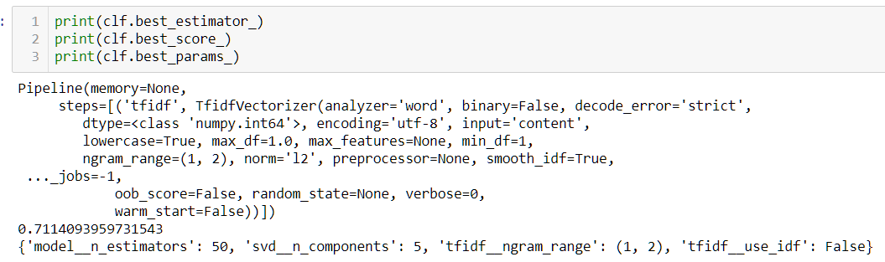
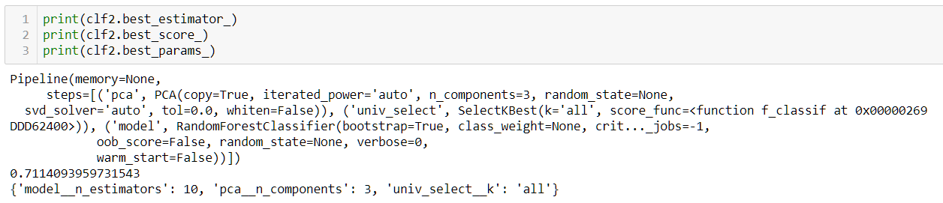
4 Optimise hyper-parameters
Description
Tweet Source
No improvement

Slide 39
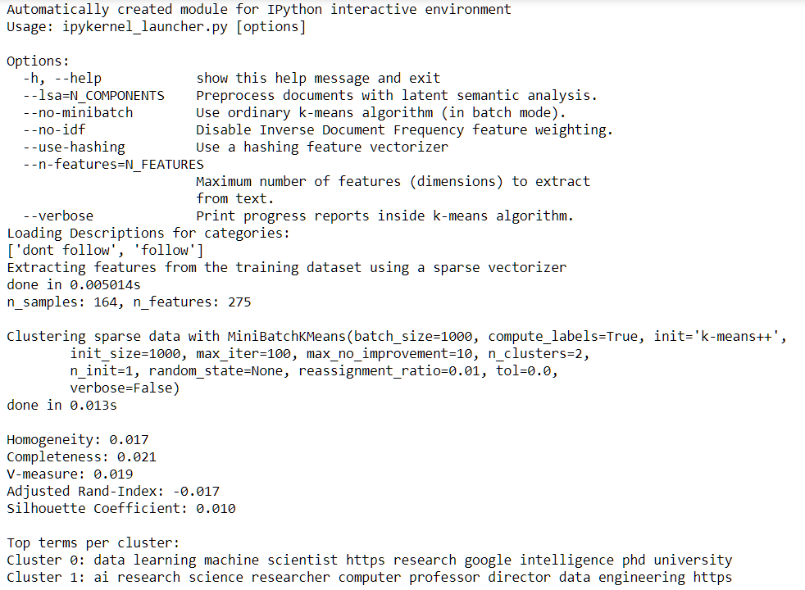
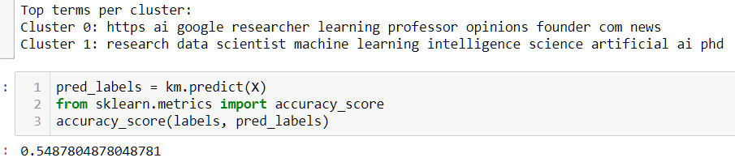
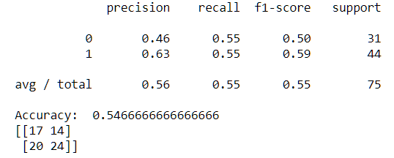
K-Means Results
Feature: Description

Slide 40
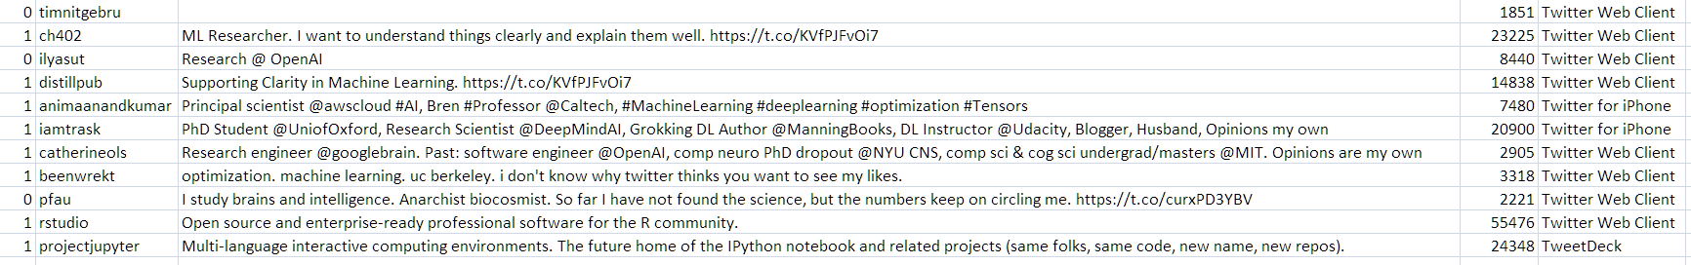
Test on new data

Slide 41
Future Growth
GENSIM with SKLearn
Collect more labelled data to improve model
Explore more features
Followers, Following
Frequency of tweets, retweets
Add more data sources (beyond twitter)
Work on 2nd Problem Statement
Categorise userIDs
Recommendation engine for top trends/interesting experts?

Slide 42
END

